Slide 1

Cost Functions and Gradient Descent

Slide 2
Deep Learning
We now understand that neural networks take in inputs, multiply them by weights, and add biases to them.
Then this result is passed through an activation function which at the end of all the layers leads to some output.

Slide 3
Deep Learning
This output ŷ is the model’s estimation of what it predicts the label to be.
So after the network creates its prediction, how do we evaluate it?
And after the evaluation how can we update the network’s weights and biases?

Slide 4
Deep Learning
We need to take the estimated outputs of the network and then compare them to the real values of the label.
Keep in mind this is using the training data set during the fitting/training of the model.

Slide 5
Deep Learning
The cost function (often referred to as a loss function) must be an average so it can output a single value.
We can keep track of our loss/cost during training to monitor network performance.

Slide 6
Deep Learning
We’ll use the following variables:
y to represent the true value
a to represent neuron’s prediction
In terms of weights and bias:
w*x + b = z
Pass z into activation function σ(z) = a

Slide 7
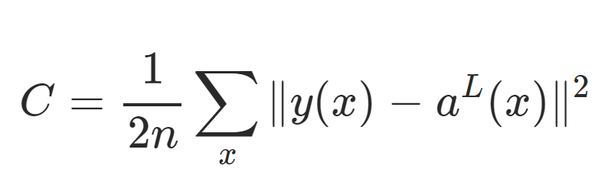
Deep Learning
One very common cost function is the quadratic cost function:

Slide 8
Deep Learning
We simply calculate the difference between the real values y(x) against our predicted values a(x).

Slide 9
Deep Learning
Note: The notation shown here corresponds to vector inputs and outputs, since we will be dealing with a batch of training points and predictions.

Slide 10
Deep Learning
Notice how squaring this does 2 useful things for us, keeps everything positive and punishes large errors!

Slide 11
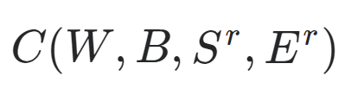
Deep Learning
We can think of the cost function as:

Slide 12
Deep Learning
W is our neural network's weights, B is our neural network's biases, S^{r} is the input of a single training sample, and E^{r} is the desired output of that training sample.

Slide 13
Deep Learning
Notice how that information was all encoded in our simplified notation.
The a(x) holds information about weights and biases.

Slide 14
Deep Learning
This means that if we have a huge network, we can expect C to be quite complex, with huge vectors of weights and biases.

Slide 15
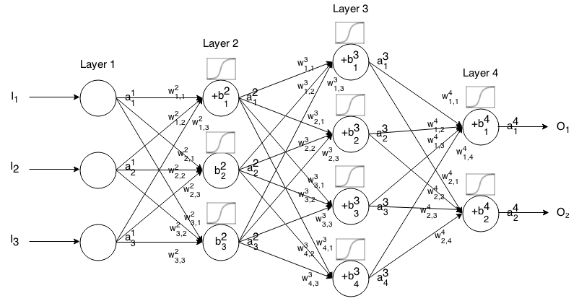
Deep Learning
Here is a small network with all its parameters labeled:

Slide 16
Deep Learning
That is a lot to calculate!
How do we solve this?

Slide 17
Deep Learning
In a real case, this means we have some cost function C dependent lots of weights!
C(w1,w2,w3,....wn)
How do we figure out which weights lead us to the lowest cost?

Slide 18
Deep Learning
For simplicity, let’s imagine we only had one weight in our cost function w.
We want to minimize our loss/cost (overall error).
Which means we need to figure out what value of w results in the minimum of C(w)

Slide 19
Deep Learning
Our “simple” function C(w)
C(w)
w

Slide 20
Deep Learning
What value of w minimizes our cost?
C(w)
w

Slide 21
Deep Learning
What value of w minimizes our cost?
C(w)
w

Slide 22
Deep Learning
What value of w minimizes our cost?
C(w)
w
wmin

Slide 23
Deep Learning
Students of calculus know we could take a derivative and solve for 0.
C(w)
w
wmin

Slide 24
Deep Learning
But recall our real cost function will be very complex!
C(w)
w

Slide 25
Deep Learning
And it will be n-dimensional!
C(w)
w

Slide 26
Deep Learning
And it will be n-dimensional since our networks will have 1000s of weights
C(w)
w

Slide 27
Deep Learning
We can use gradient descent to solve this problem.
C(w)
w

Slide 28
Deep Learning
Let’s go back to our simplified version to see how this works.
C(w)
w
wmin

Slide 29
Deep Learning
We can calculate the slope at a point
C(w)
w
wmin

Slide 30
Deep Learning
We can calculate the slope at a point
C(w)
w
wmin

Slide 31
Deep Learning
Then we move in the downward direction of the slope.
C(w)
w
wmin

Slide 32
Deep Learning
Then we move in the downward direction of the slope.
C(w)
w
wmin

Slide 33
Deep Learning
Then we move in the downward direction of the slope.
C(w)
w
wmin

Slide 34
Deep Learning
Until we converge to zero, indicating a minimum.
C(w)
w
wmin

Slide 35
Deep Learning
We could have changed our step size to find the next point!
C(w)
w
wmin

Slide 36
Deep Learning
Our steps:
C(w)
w
wmin

Slide 37
Deep Learning
Smaller steps sizes take longer to find the minimum.
C(w)
w
wmin

Slide 38
Deep Learning
Larger steps are faster, but we risk overshooting the minimum!
C(w)
w
wmin

Slide 39
Deep Learning
This step size is known as the learning rate.
C(w)
w
wmin

Slide 40
Deep Learning
The learning rate we showed in our illustrations was constant (each step size was equal)
But we can be clever and adapt our step size as we go along.

Slide 41
Deep Learning
We could start with larger steps, then go smaller as we realize the slope gets closer to zero.
This is known as adaptive gradient descent.

Slide 42
Deep Learning
In 2015, Kingma and Ba published their paper: “Adam: A Method for Stochastic Optimization“.
Adam is a much more efficient way of searching for these minimums, so you will see us use it for our code!

Slide 43
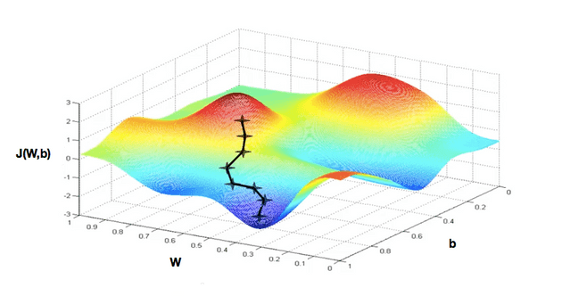
Deep Learning
Realistically we’re calculating this descent in an n-dimensional space for all our weights.

Slide 44
Deep Learning
When dealing with these N-dimensional vectors (tensors), the notation changes from derivative to gradient.
This means we calculate ∇C(w1,w2,...wn)

Slide 45
Deep Learning
For classification problems, we often use the cross entropy loss function.
The assumption is that your model predicts a probability distribution p(y=i) for each class i=1,2,…,C.
Cross Entropy Loss → https://towardsdatascience.com/cross-entropy-loss-function-f38c4ec8643e

Slide 46
Deep Learning
Review:
Cost Functions
Gradient Descent
Adam Optimizer
Quadratic Cost and Cross-Entropy

Slide 47
Deep Learning
So far we understand how networks can take in input , effect that input with weights, biases, and activation functions to produce an estimated output.
Then we learned how to evaluate that output.

Slide 48
Deep Learning
The last thing we need to learn about theory is:
Once we get our cost/loss value, how do we actually go back and adjust our weights and biases?
This is backpropagation, and it is what we are going to cover next!

